Slide 1
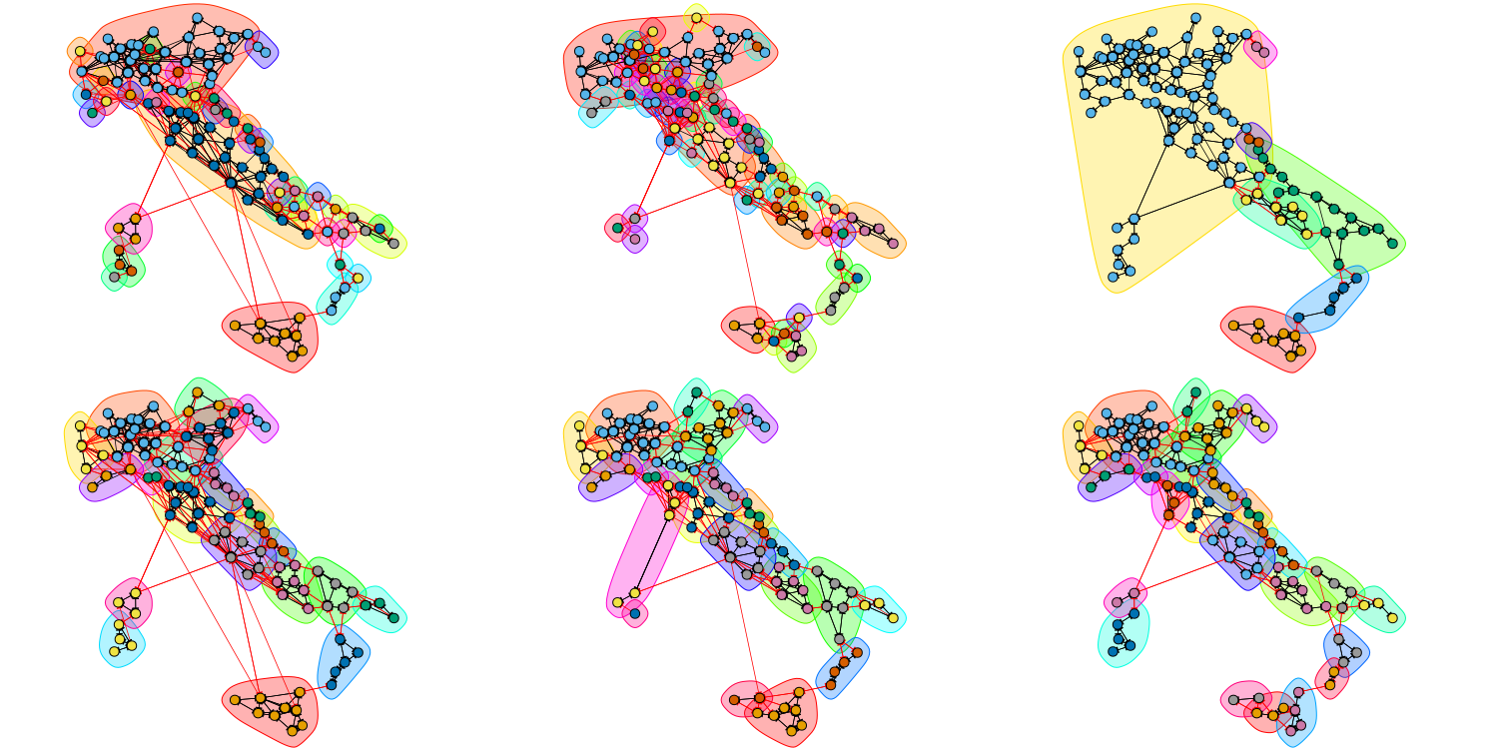


Impact of Italy’s COVID-19 Lockdown
on National Mobility Networks
Final project for the Social Network Analysis course
Gabriele Sarti and Enrico Fallacara, University of Trieste, Academic Year 2020/2021

Slide 2
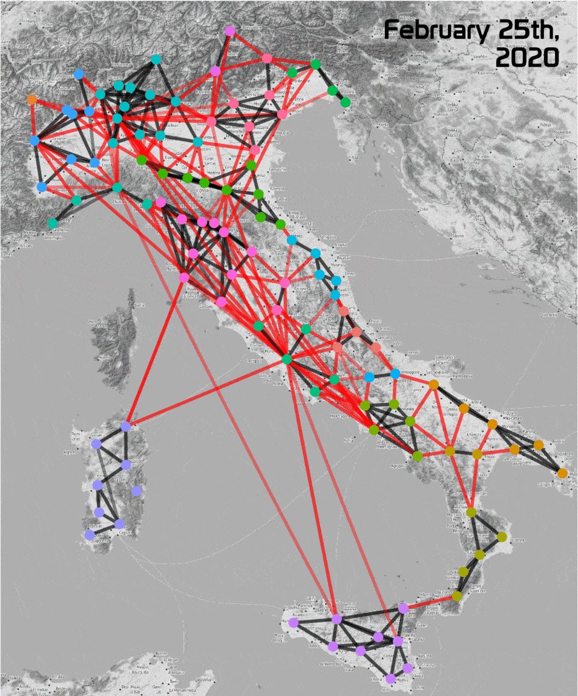
The goal of this project is to analyze how Italian mobility trends have shifted during the three phases of the 2020 lockdown, focusing on three specific dates:
First lockdown (February 21st, 2020)
National lockdown (March 10th, 2020)
Reopening of inter-regional travel (May 5th, 2020)
We used Movement Range Maps published by Facebook on the Humanitarian Data Exchange platform, considering only raw estimated movements at the provincial level.
We focus mostly on the analysis of inter-provincial movements, that we deem as most interesting.

Slide 3
Diachronic Descriptive Analysis

Slide 4
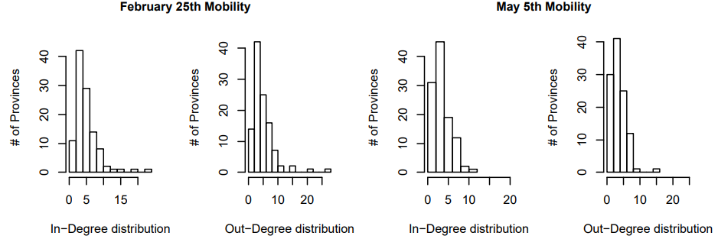
In all three dates, mobility networks are directed, weighted (according to the raw mobility weight value), and disconnected. We observe drastic mobility reduction for most well-connected provinces.

Slide 5
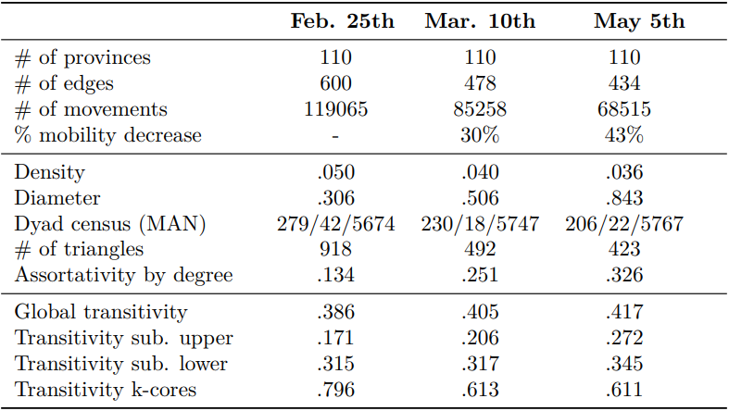

Slide 6
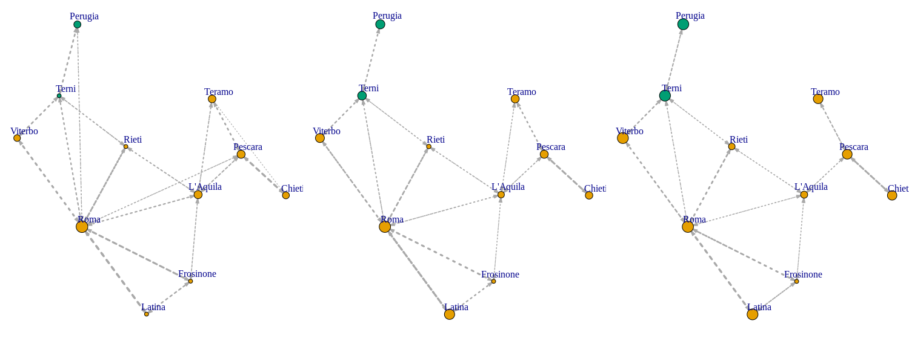
Mobility situation of provinces belonging to Lazio, Umbria, and Abruzzo. Edge size represents the number of raw movements, while vertex size represents the betweenness of nodes in the total network.

Slide 7
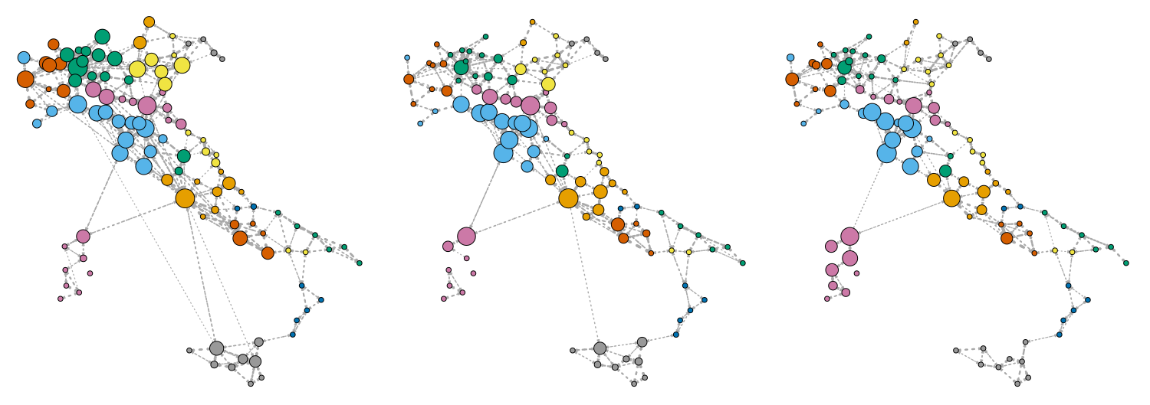
Mobility for provinces on the whole territory. Edge size represents the number of raw movements, while vertices sizes and colors represent the eigenvector centrality and the regional membership of nodes in the network.

Slide 8
2. Analyzing Mobility Communities

Slide 9
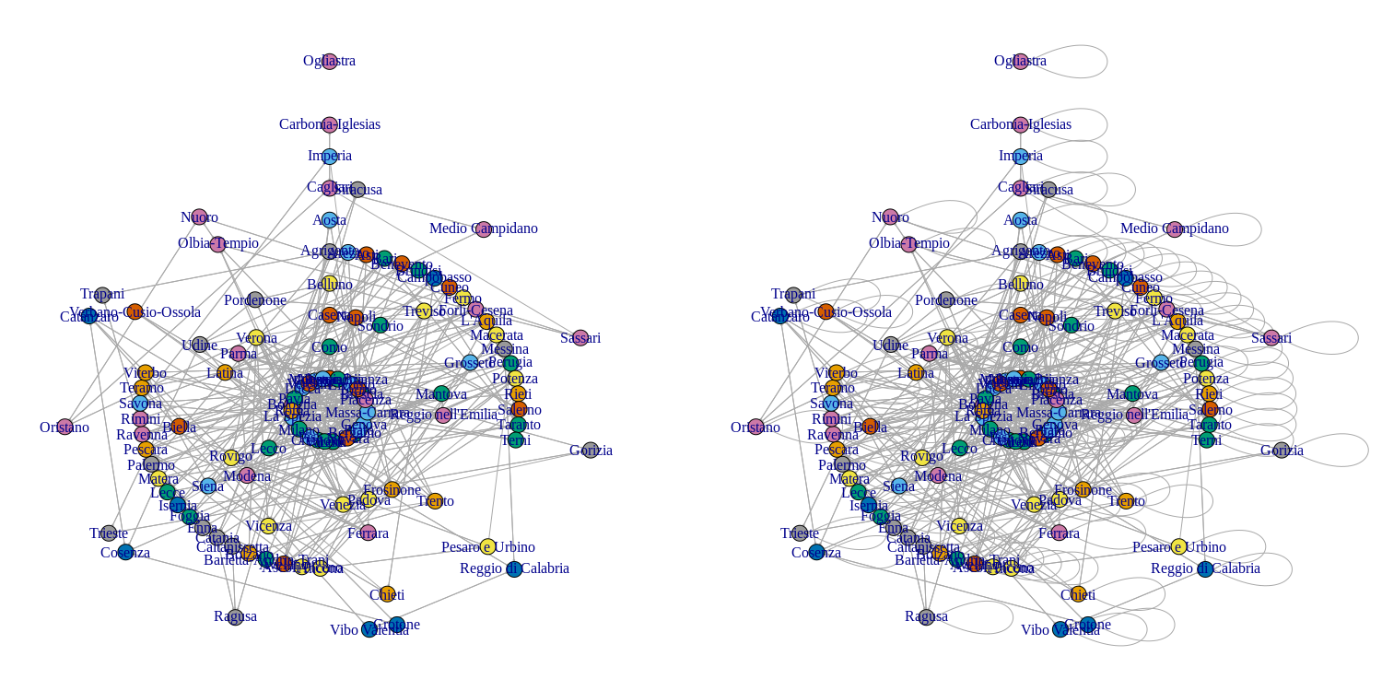
Coreness values of provinces (February 25th), for inter-provincial movements only (left) and all movements (right).

Slide 10
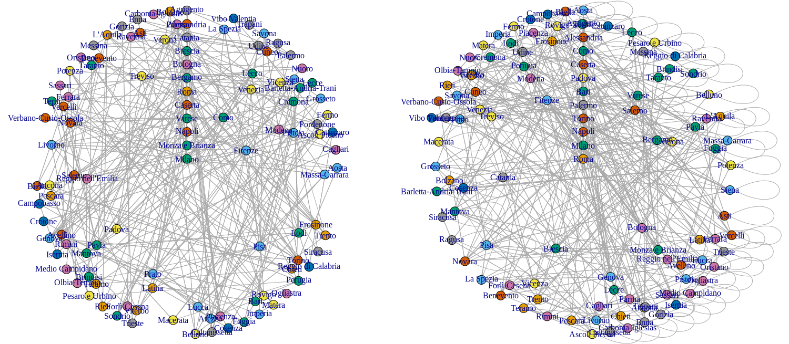
Weighted coreness values of provinces in the mobility network (February 25th), respectively for inter-provincial (left) and all movements (right)

Slide 11
Communities highlighted by the Girvan-Newman (top) and the Label Propagation (bottom) clustering algorithms.

Slide 12
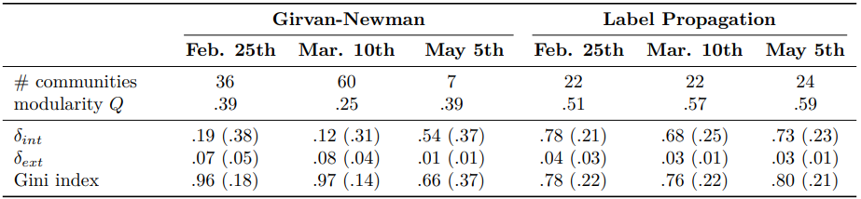
Community detection results produced by Girvan-Newman and Label Propagation algorithms:
We could not easily apply hierarchical modularity optimization approaches since the network is directed.

Slide 13
3. Modeling Mobility Patterns

Slide 14
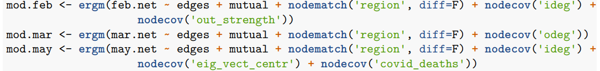
To achieve a better quality of fit on our networks, we used some auxiliary data that can provide additional useful information to the model:
Province d’Italia data (Wikipedia) , that contains informations about population, population density, surface and municipalities at provincial level.
COVID-19 Italy official data , which contains information about the number of COVID cases at province level and the number of COVID-related fatalities at regional level.
After adding these variables, we start by specifying and estimating three ERGM models, one for each analyzed day.

Slide 15
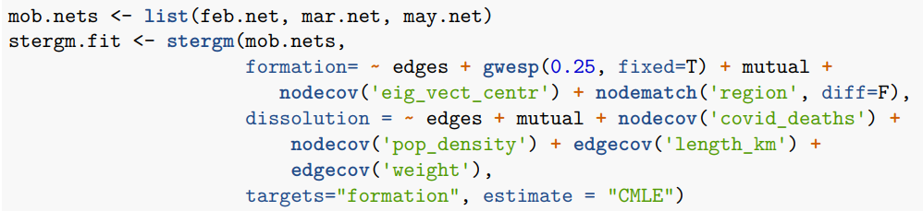
Moving to a dynamic mobility network, using STERGM, is highly desirable since it allows us to focus our analysis on tie dynamics (both formation and dissolution of edges) and attribute dynamics (e.g. change in nodes inbound and outbound strengths).
STERGMs are composed by a model for tie formation and one for tie dissolution that are assumed as independent from each other. We use MCMC for fitting the models, using conditional maximum likelihood estimation (CMLE) as fitting procedure.

Slide 16
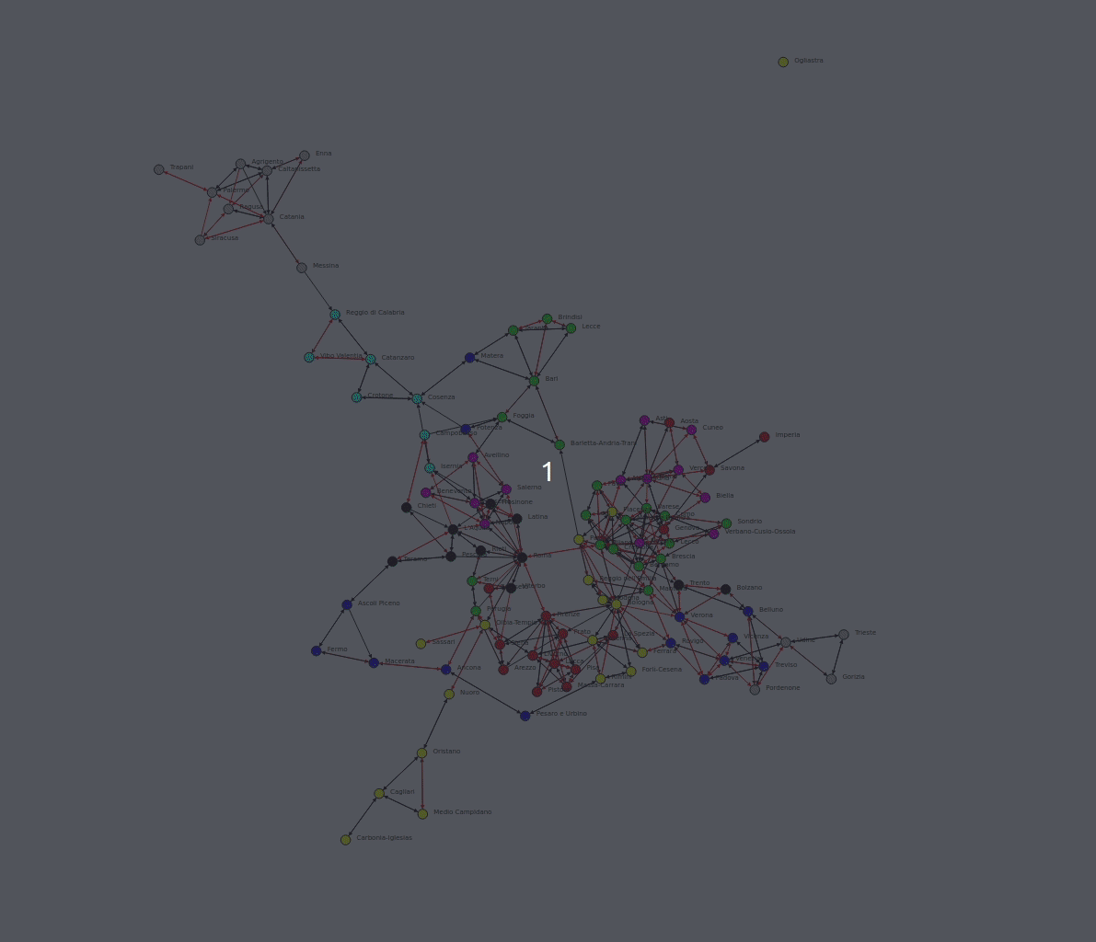
Simulating Network Temporal Evolution with a STERGM Model

Slide 17
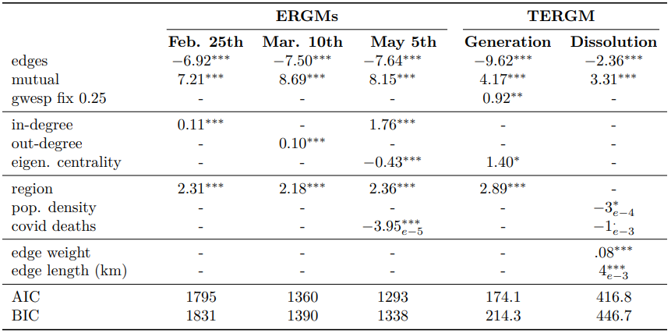

Slide 18
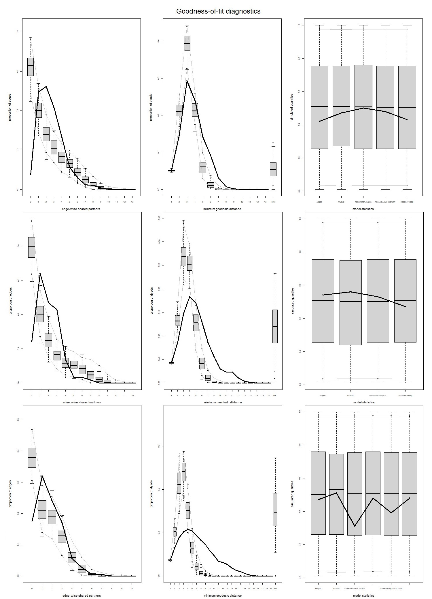
ERGM models show some sort of performance decay, where the goodness-of-fit diagnostics for the MCMC procedure worsen over time for different configurations, despite remaining quite acceptable for our purposes.
We observe how the best model fitted on May 5th data badly mimics geodesic distances and some network attributes.

Slide 19
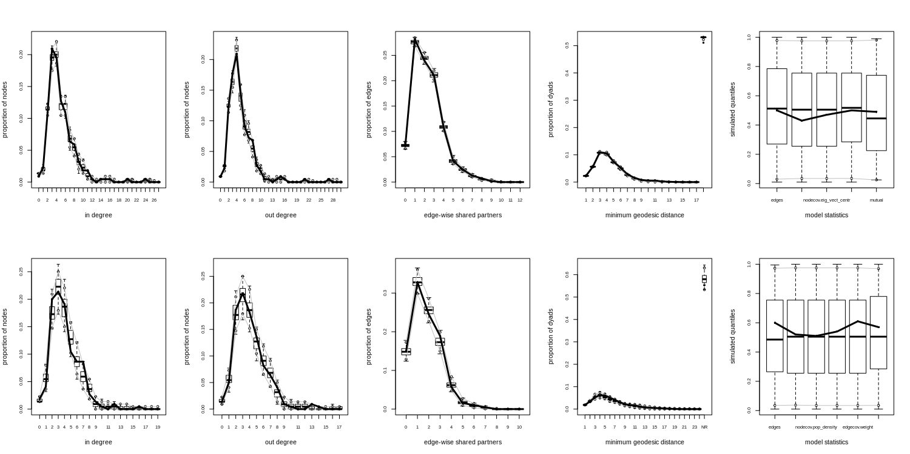
STERGMs provide a much better goodness of fit for the mobility network at all times.

Slide 20
Conclusion

Slide 21
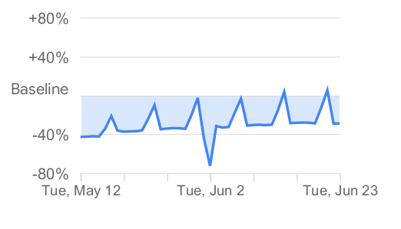
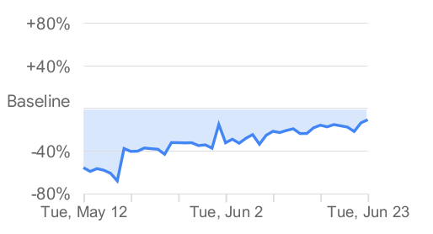
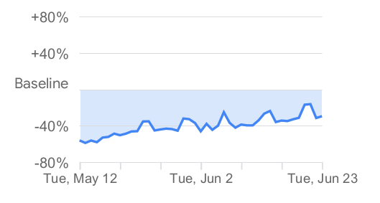



We conclude by comparing our results with Google Global Mobility Report, which measures daily visitors counts for specific location categories (e.g. train stations, workplaces, residential areas) and compares shifts in mobility as variations relative to a baseline day before the pandemic outbreak.
Focusing on the Italy report, we can see that the reduction of movements towards workplaces, for retail and recreation and towards transit stations estimated for May 12th (roughly 40-50%) is very similar to the results obtained from our mobility network (43%). This coherence in empirical observations acts as further support to the validity of our findings. The current situation seems to be improving ever since.

Slide 22
This analysis was by no means intended to cover all the interesting phenomena underlying such monumental shifts in mobility trends. We believe, instead, this research might be interesting to better understand the behavior of the Italian mobility network, and possibly make it more robust to counter future adversities.

Slide 23
THANK YOU FOR YOU ATTENTION!
Repository of the project at:
https://github.com/gsarti/lockdown-mobility-analysis

